Slide 1
Real Time Object Detection through Webcam
Proposed by:
1. Muhammad Talha munir
2. Muhammad Yamin
3. Aqsa majeed

Slide 2
Agenda
Introduction
Problem statement
Methodology
Results
Conclusion

Slide 3
Introduction

Slide 4
Background
Computer Vision Introduction and History
Subfield of Artificial Intelligence
Uses Neural Networks for object detection from images and videos
Started back in 1950s but failed due to lack of data and processing power
First time used for used in the 1970s for the interpretation of hand-written text for visually impaired people
Improved with the help of large amount of data and processing power

Slide 5
Need
Used for object detection and object segmentation
Used in image processing for detecting the malicious cancerous cells, classification of cars from CCTV videos, to live process of football matches, in self-driving cars, in augmented and virtual reality.
In our project, to detect the object and present the output in voice command

Slide 6
Objectives
Implement machine learning model with object detection
First, classify the hand in front of webcam into empty or non-empty
if empty, voice message “hand is empty”
if non-empty, detect the object and give voice message with object name

Slide 7
Problem statement

Slide 8
Problem statement
Objective is to detect the real-time objects through a webcam
Will achieve using object classification and localization simultaneously
Previously, no model proving output in voice command

Slide 9
Methodology

Slide 10
Methodology
The project has two main subtasks
Hand Detection
Object detection
Checking for empty hands
Voice command to tell user which object is in the frame

Slide 11
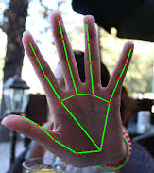
Methodology cont…
Hand detection Model
Basic computer vision task
Dozens of model and algorithm available that can detect hands and its positioning
OpenCV is a powerful python library
It provides CVzone package that contain built in tools for many detection problems
Hand Detection module of cvzone provide Bounding boxes and different hand gestures using hand landmarks.

Slide 12
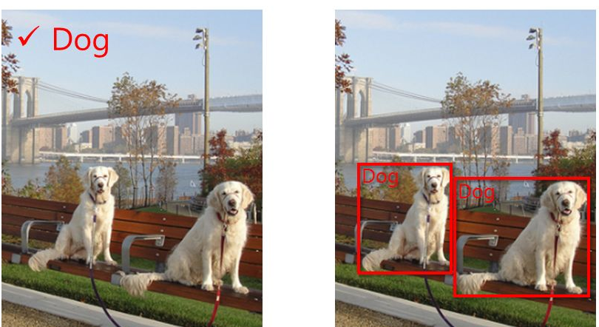
Methodology cont…
Object detection model
It is a combination of image
Classification and image localization
Deep learning model gain popularity Because of
the large data resources
Pretrained model that are trained on large
datasets are used for object detection.
Vgg16 trained on ImageNet
Yolo V5 trained on coco
Yolo V3 trained on coco

Slide 13
Major Outcomes

Slide 14
Major Outcomes
Frontend
An interactive dashboard
Inputs of the Model
Webcam
Backend
ML model will be deployed (Coco Dataset)
Output
Object detection
Model will respond in voice

Slide 15
Conclusion

Slide 16
Conclusion
Machine learning has reshaped the world
Transformed variety of industries, including healthcare, education, transportation, food, entertainment, and various manufacturing lines.
Object Detection become a major concern in many fields such as traffic surveillance, detection of stolen things, the medical field, etc.
ImageNet dataset will be used to train the model and deep learning and Open CV techniques will be used
The resultant system will have a momentous significance in the society.

Slide 17
Thank you

